Slide 1
Every penny counts, but not equally: Accelerators and bottlenecks in investor ecosystems
David Dekker, Folker Pieterse, Stefan Köppl, Victor Rosenberg, Dimitris Christopoulos
Heriot-Watt University, Edinburgh, U.K.
Free University, Amsterdam, The Netherlands
April 2023

Slide 2
Introduction
Successful innovation as source of income inequality and social mobility (Aghion, et al. 2021, ch.5, p.82)
Not related to Gini coefficient, but to 1%’s income share
Increases social mobility through creative destruction
Stimulates productivity growth
Financial risks in green innovations (Pitchbook, white paper; The Economist)
Incentives to minimize risks and maximize yield may ‘bias’ the direction of innovation through investors’ syndication.
Direction is a function of Risk and expected Yield

Slide 3
Research Question
What effect does the endogenous development of a syndication network have on the success of early-stage companies?
What direction will investments take?
What does this imply for industrial decarbonation?
The case of early-stage hydrogen companies.

Slide 4

Syndication structure of investors
No reptile conspiracy!
Structures of Trust, Risk and Reputation
Definition of trust: “the willingness of a party to be vulnerable to the actions of another party based on the expectation that the other will perform a particular action important to the trustor, irrespective of the ability to monitor or control that other party.” (Mayer et al. 1995)
Syndication signals mutual trust (Deutsch 1958)
2 or more in a syndicate
Embedded syndication signals enforceable norms (Coleman 1988)
3 or more in a syndicate
Reputational vulnerability increases with syndication closure (i.e., Merry 1984; Portes and Sensenbrenner, 1993)
number of syndication partners that have joint investments
'people of the same trade seldom meet together, even for merriment and diversion, but the conversation ends in a conspiracy against the public, or in some contrivance to raise prices’ (Adam Smith, WN [1776] 1992)

Slide 5
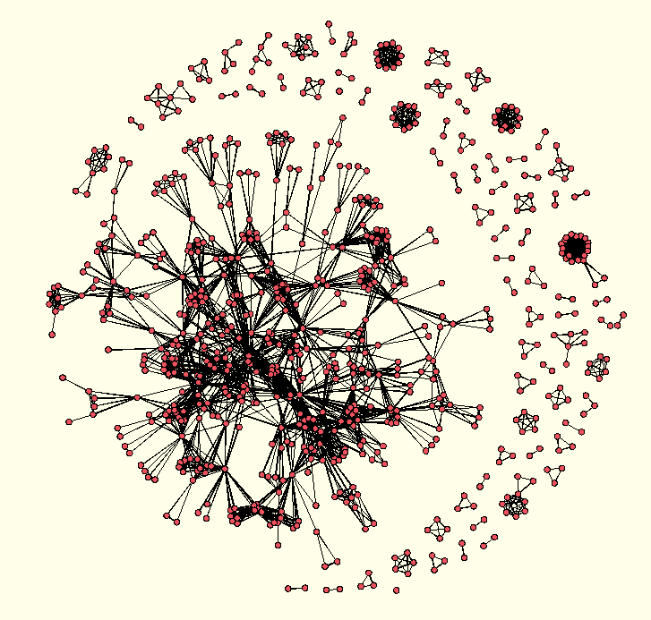
Hydrogen co-investments 1998-2023

Slide 6
Hypotheses
Later stage companies will have received more total funds (+)
More investors will increase the total funding (+)
Increasing syndication closure around a company will lower the investments in this company (-)
Reputational precaution
Increased observability leads to cautious behavior
Degree, Recency, Coinvestment 2-steps, Syndication 2-steps

Slide 7
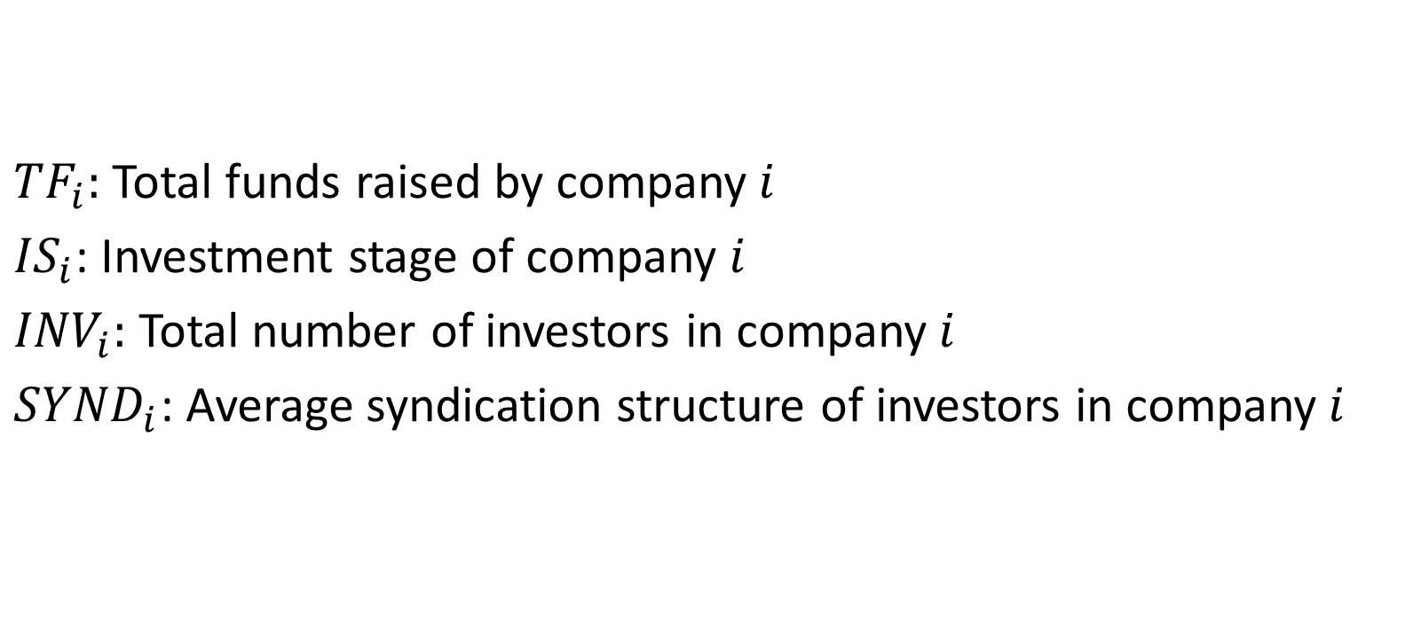
Model I
${TF}_{i}:$ Total funds raised by company$i$
${IS}_{i}$: Investment stage of company $i$
${INV}_{i}:$ Total number of investors in company$i$
${SYND}_{i}$: Average syndication structure of investors in company$i$
$${TF}_{i}=f({IS}_{i},{INV}_{i},{SYND}_{i})$$ | (1)

Slide 8
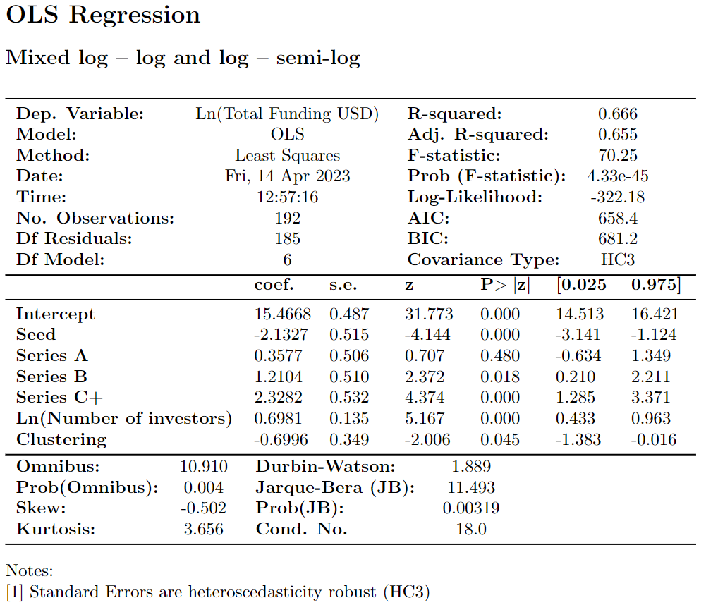
Results

Slide 9
Relational Event Model
Network endogenous variables | Coef. Est. | s.e. | Z value | Pr(>|z|)
Degree (# of syndications) | 27,844 | 2,399 | 11,605 | < 2.2e-16 | ***
Recency | -8,201 | 0,948 | -8,652 | < 2.2e-16 | ***
Referal | 1,309 | 0,186 | 7,022 | 2,18E-09 | ***
Clustering | -0,448 | 0,208 | -2,155 | 0,031 | *
Signif. codes: 0 ‘***’ 0.001 ‘**’ 0.01 ‘*’ 0.05 ‘.’ 0.1 ‘ ’ 1 Chi-square: 714.8939 on 4 degrees of freedom, asymptotic p-value 0 AIC: 1709.597
Degree
t + 1
t
t+1
t
Referal
Clustering

Slide 10
Conclusions
Bottlenecks
Investors that team up too much (maximal difference could be as large as 69%)
More investors increase funding, but at a decreasing rate (elasticity <1)
Lack of diversity of investors
Accelerators
high risk, capital intensive:
single large investors that are less sensitive for reputation effects, because they can lead the syndication with many smaller investors
Portfolio investments

